Slide 1
Study Research
Analysis of Stock Price Variance Close To Annual And Quarterly Report Filing Dates
Nelson Corrocher, M.B.A.
Adela Devarajan
Nikoloz Lelashvili

Slide 2
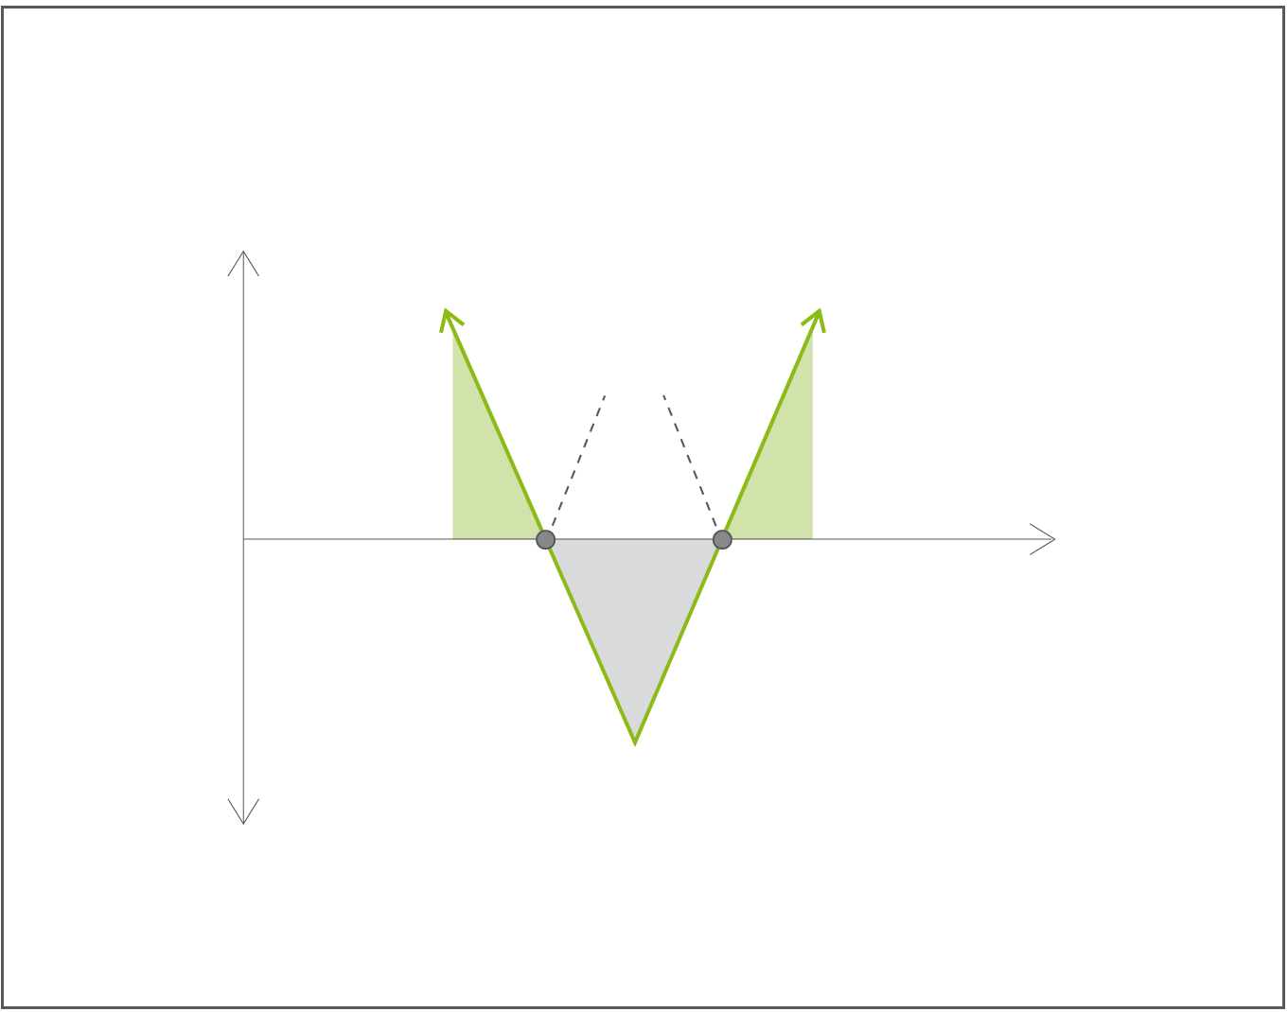
Option Straddle: Definition
Strategy in which the investor holds a position in both a call and put with the same strike price and expiration date, paying both premiums. This strategy allows the investor to make a profit regardless of whether the price of the security goes up or down, assuming the stock price changes somewhat significantly.
Profit
Breakeven
Profit
Profit
Stock Price
Loss
Loss

Slide 3
Hypothesis:
“Price variance of public companies stocks increase close to the filing date of its financial statements”
If true:
Potential for systematic straddling strategy with higher Sharpe Ratio⁽¹⁾ than other passive strategies.
⁽¹⁾ measure for calculating risk-adjusted return.

Slide 4
Procedure
R scripting used for almost entire procedure:
Data collection
Web scraping:
SEC.org EDGAR;
Yahoo Finance;
Data clean-up;
Data transformation;
Data tidying;
Analysis
Variance test;
Hypothesis test;
Data plotting;
Paper Creation
Paper formatting;
Reproducibility;
Bibliography;

Slide 5

Results
## [1] "Regular set variance: 0.99"
## [1] "Release set variance: 1.09"
##
## F test to compare two variances
##
## data: finalData.reg and finalData.fin
## F = 0.9, num df = 30000, denom df = 3000, p-value = 6e-04
## alternative hypothesis: true ratio of variances is not equal to 1
## 95 percent confidence interval:
## 0.86 0.96
## sample estimates:
## ratio of variances
## 0.91

Slide 6
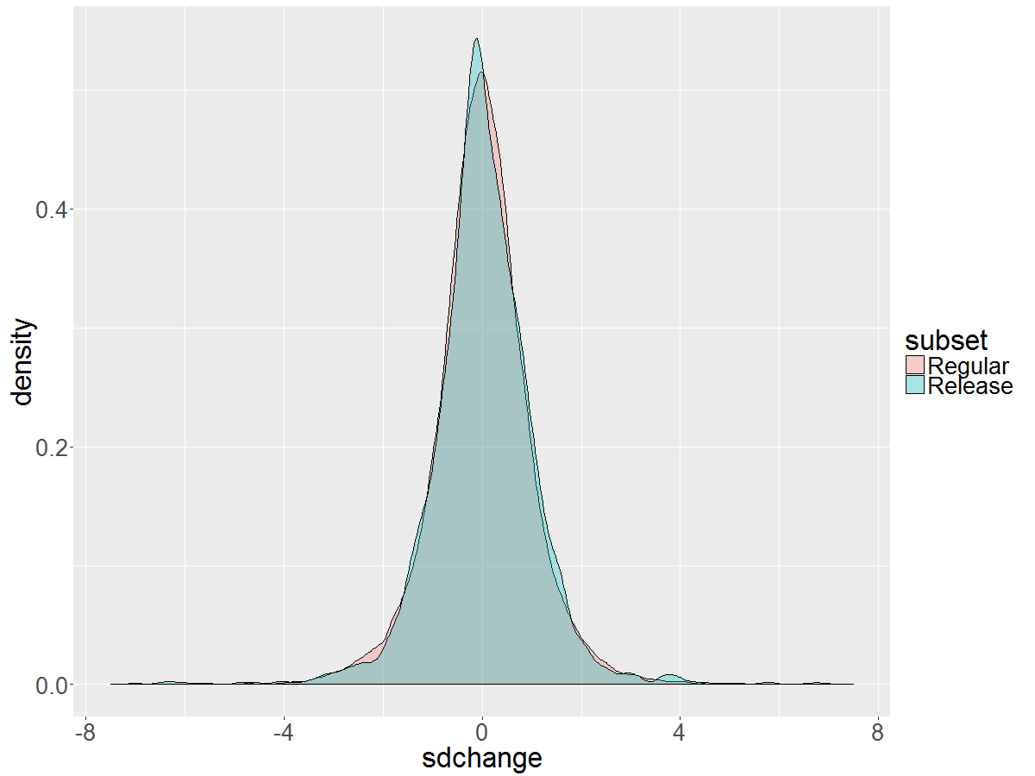
Results – Superposed distribution density of the two datasets.

Slide 7
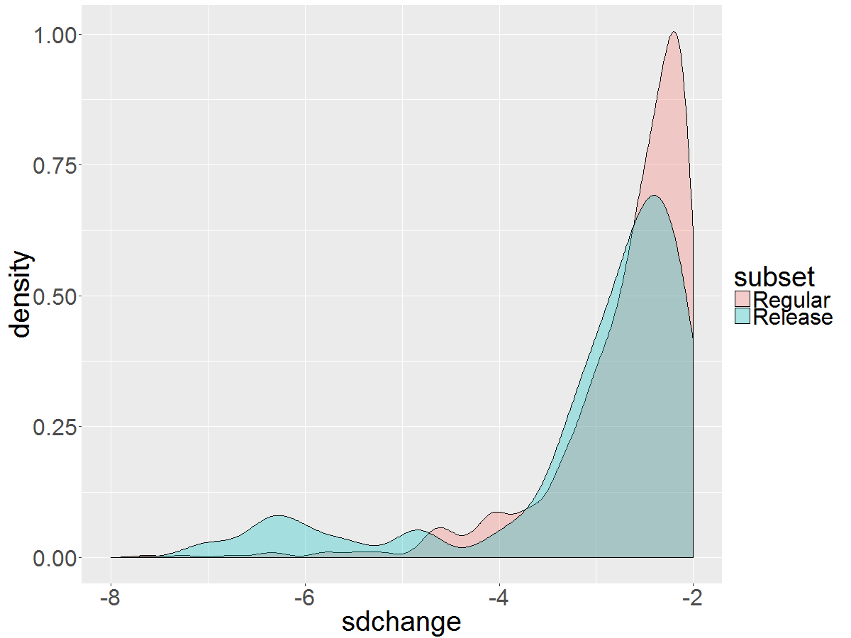
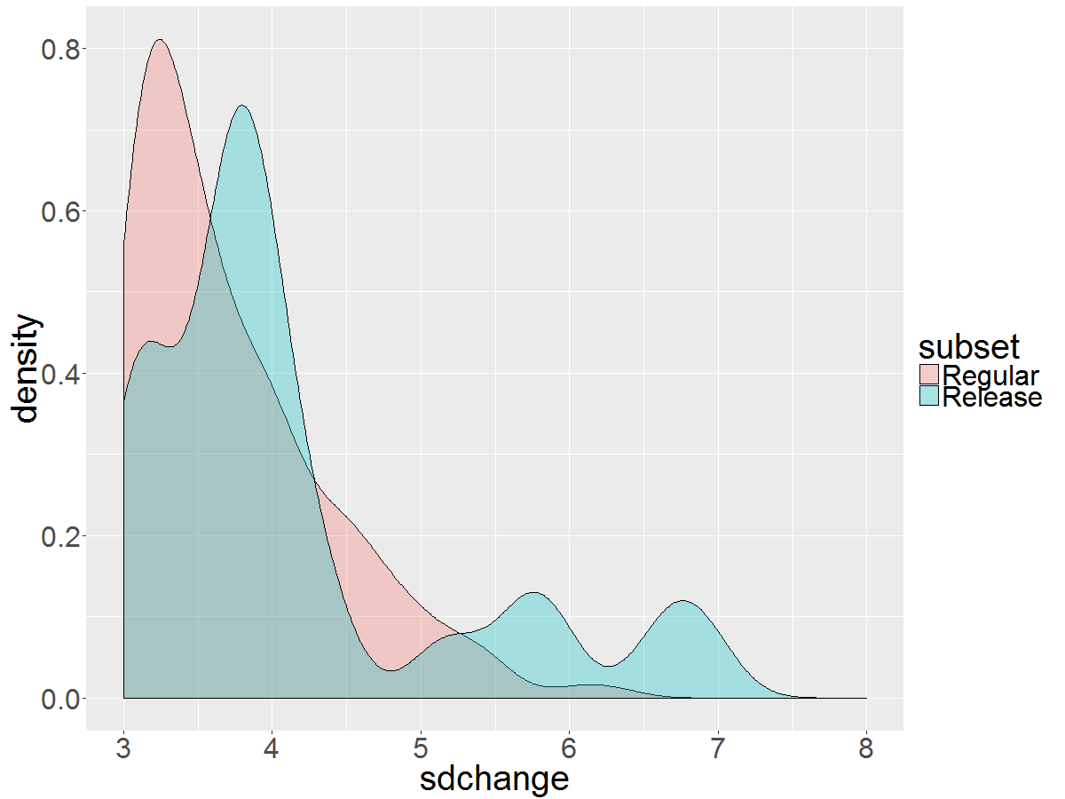
Results – Distribution zoomed on tails
Left Tail
Right Tail
Distribution gets very different in the tails especially below -5 and above 5.

Slide 8
Next Steps
Stock options collection;
Strategy Design and Optimization;
Simulation and Back Testing;

Slide 9

THANKS!

